Slide 1
Prescription savings campaign
comms toolkit

Slide 2
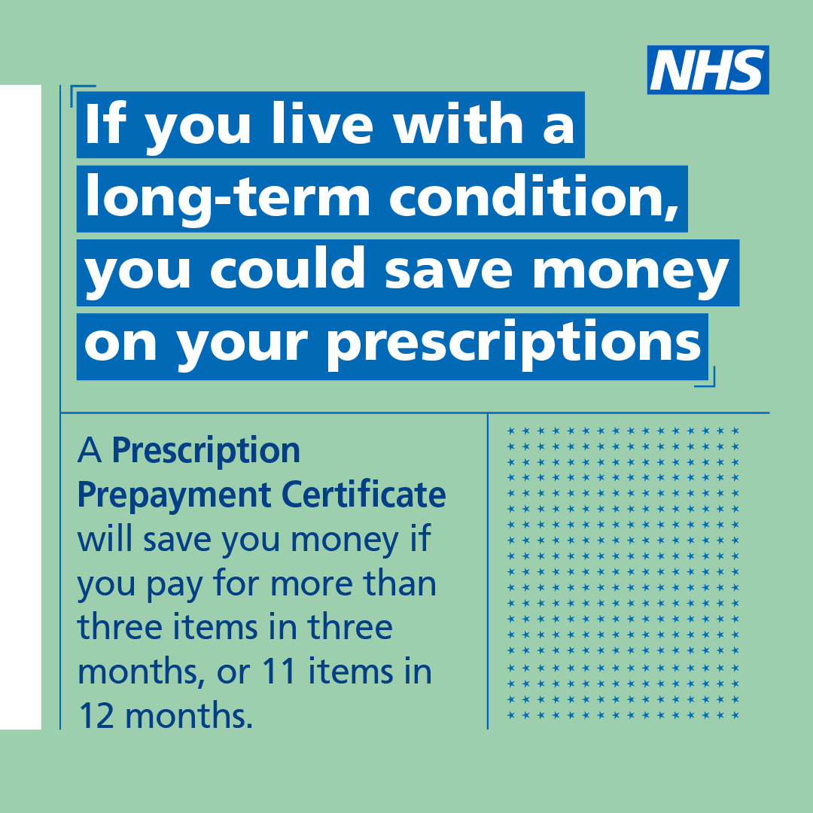
What is the campaign?
Background
Prescribing data from NHS BSA shows that people living in the most deprived parts of England receive significantly more prescription items than those living in less deprived areas.
A Healthwatch poll also found that one in ten (10%) people have avoided taking up one or more NHS prescriptions because of the cost, due to the cost of living crisis.
Objectives/Aims
The campaign aims to raise awareness of the two prescription money saving schemes available to patients:
The Prescription Prepayment Certificate, and
The Low Income Scheme

Slide 3
Audience
Audience(s)
People living with long-term conditions; particularly those living with Sickle Cell, Asthma, MND, HIV, Parkinson’s and MS, and those living in deprived areas
Healthcare staff, particularly GP Practice staff and Pharmacy staff

Slide 4
Key messages
Key messages – for patients
If you live with a long-term condition, you may be able to save money on your prescriptions
A Prescription Prepayment Certificate will save you money if you pay for more than three items in three months, or 11 items in 12 months.
If you are on a low income, you could be entitled to help with NHS costs or free prescriptions depending on your circumstances. Check if you’re eligible for help using the online eligibility checker. It only takes a few minutes.
Key messages – for healthcare staff
Remind the patients you see that live with a long-term conditions that they may be able to save money on their prescriptions
A Prescription Prepayment Certificate will save people money if they pay for more than 3 items in 3 months, or 11 items in 12 months.
People on a low income could be entitled to help with NHS costs or free prescriptions depending on their circumstances. People can check if they’re eligible for help using the online eligibility checker. It only takes a few minutes.

Slide 5
Key messages
Call to action
Find out more about Prescription Prepayment Certificates at www.nhsbsa.nhs.uk/ppc.
Check if you’re eligible for help with prescription costs by using the online eligibility checker at www.nhsbsa.nhs.uk/check.
Are there regionalised messages?
Regions can include local stats on patients living with long term conditions within their patch i.e. number of people. Regions with deprived areas may also want to target these populations.
You can find a list of the 20 most common long-term conditions at the following link and see by region/STP/CCG level: https://digital.nhs.uk/news/2021/prevalence-data-for-20-common-conditions-published-today
ONS holds data on household deprivation down to induvial ward level, this may be helpful in targeting areas with the highest need in your areas: https://www.ons.gov.uk/census/maps/choropleth/population/household-deprivation/hh-deprivation/household-is-not-deprived-in-any-dimension
Example: Ahead of winter, XXX is looking at how we can best support our patients and communities in light of the rising cost of living. This includes [insert the range of local initiatives]. In [area] over XXX people suffer from long term conditions and XXX live in areas of socioeconomic deprivation.

Slide 6
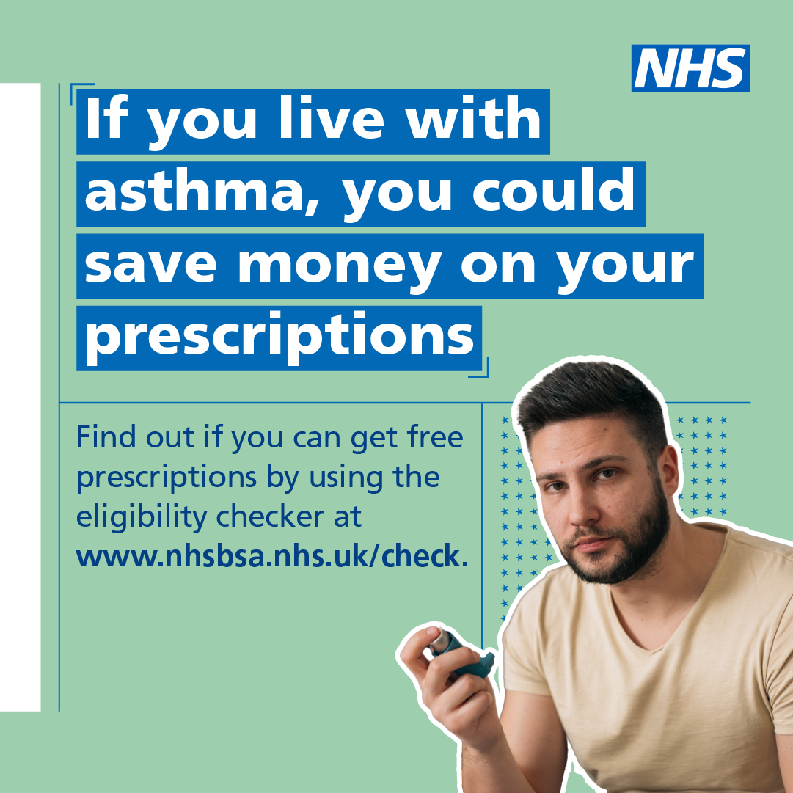
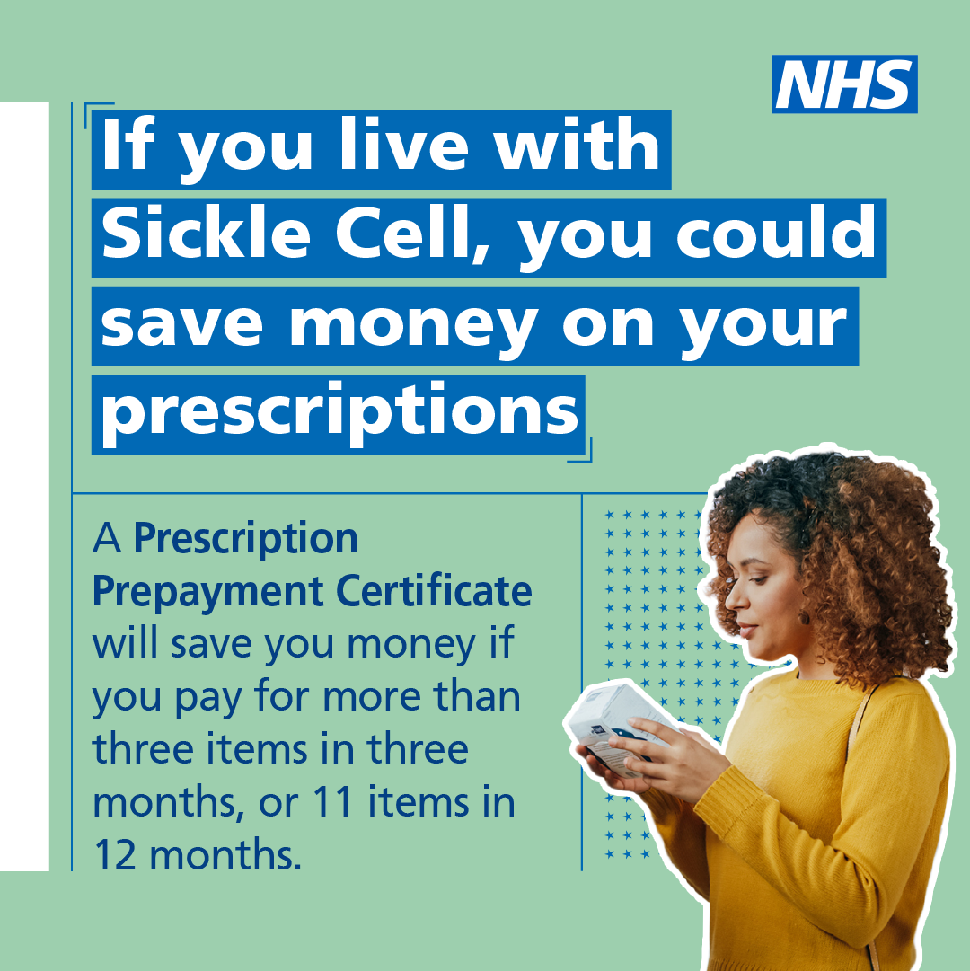
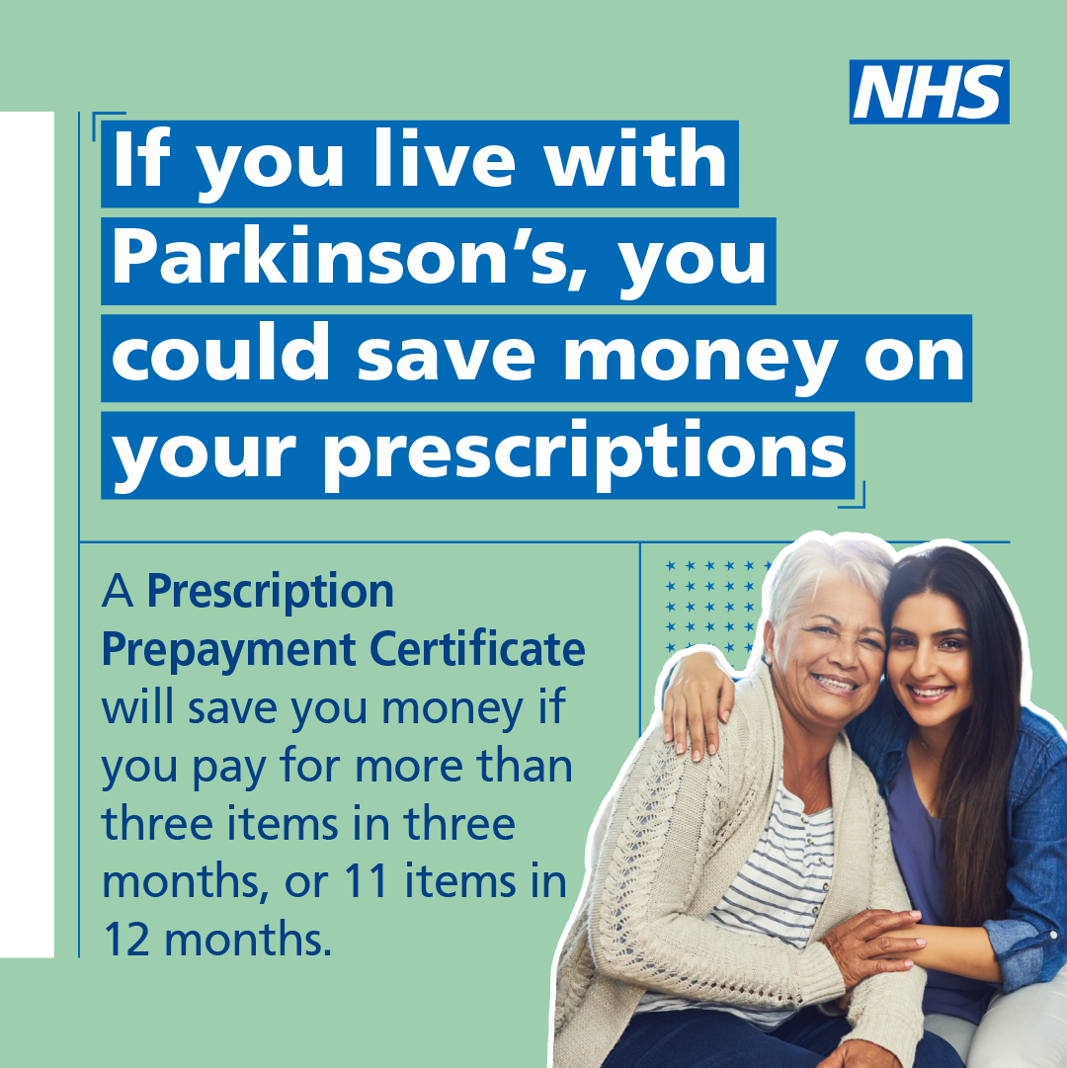
Key messages
Condition-specific messages
We have created some condition-specific assets for use by relevant stakeholders and in relevant regions.
The conditions include:
Sickle cell
Asthma
MND
HIV
Parkinson’s
MS
Regions with high populations of people with these conditions should consider using these graphics too alongside the general long-term condition messaging i.e. London region sharing sickle-cell messaging

Slide 7
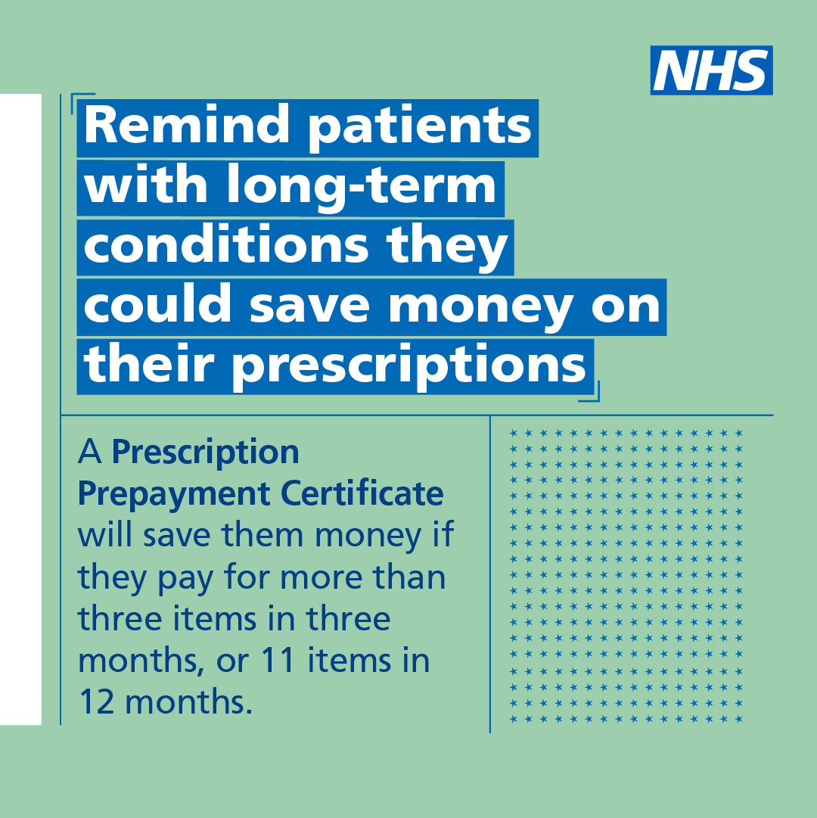
Top three ways to help
Share the graphics and messages on social media, via email bulletins and staff intranets
Download campaign materials from the Campaign Resource Centre and share with colleagues, local communications networks, community organisations etc. Particularly think about local groups that support people living with long term conditions or people on a low income.
Encourage staff to remind their patients about the prescription saving schemes.
You can find all resources on the Campaign Resource Centre from Monday 25 September – Resources should not be used until Monday 2 October 2023

Slide 8
Example social media posts
Example posts for Twitter – Prescription Prepayment Certificate
Patients with long-term conditions could save money on their prescriptions.
A Prescription Prepayment Certificate will save people money if they pay for more than three items in three months, or 11 items in 12 months.
Remind patients to check their eligibility at www.nhsbsa.nhs.uk/ppc.
Always up-to-date image size guide for Twitter can be found here

Slide 9
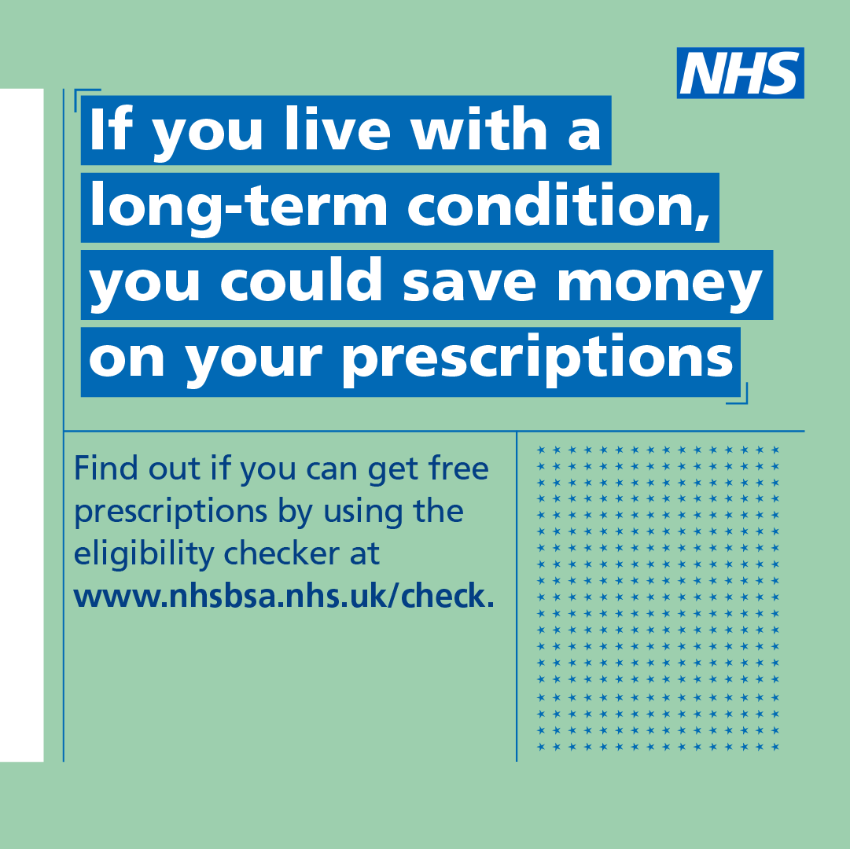
Example social media posts
Example posts for Twitter – Low income scheme
Patients with long-term conditions could save money on their prescriptions.
If they are on a low income, they could be entitled to help with costs or free prescriptions.
People can check if they’re eligible for help at www.nhsbsa.nhs.uk/check.
Always up-to-date image size guide for Twitter can be found here

Slide 10
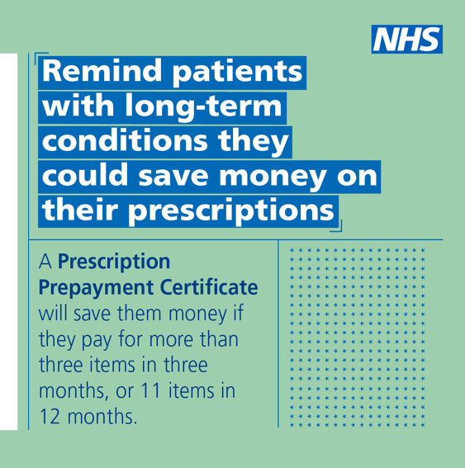
Example social media posts
Example posts for LinkedIn – Healthcare-facing messages
Patients with long term conditions could save money on their prescriptions.
A Prescription Prepayment Certificate will save people money if they pay for more than 3 items in 3 months, or 11 items in 12 months.
Remind patients to check their eligibility at www.nhsbsa.nhs.uk/ppc.
Always up-to-date image size guide for LinkedIn can be found here.

Slide 11
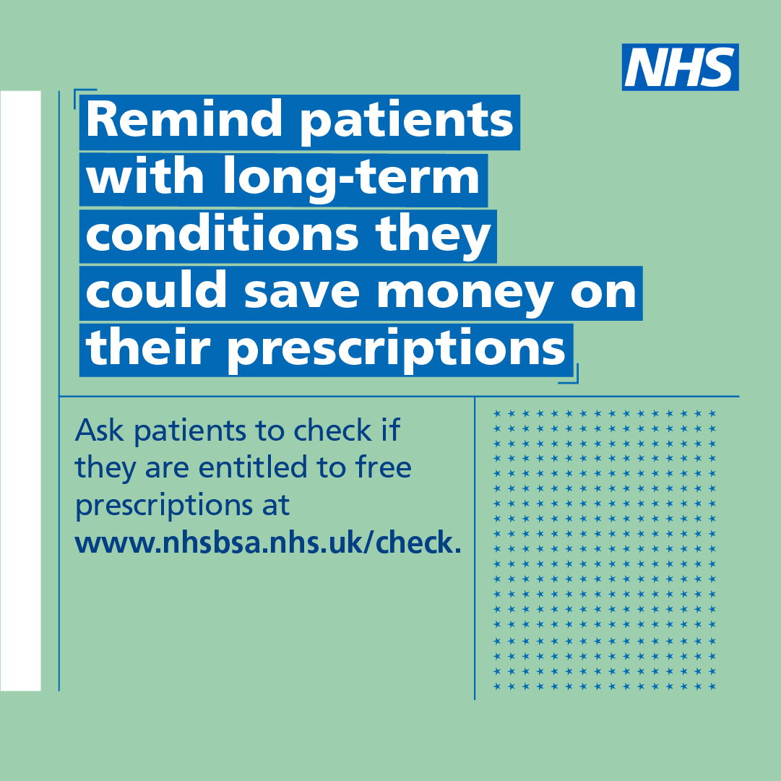
Example social media posts
Example posts for LinkedIn – Healthcare-facing messages
Patients with long term conditions could save money on their prescriptions.
If they are on a low income, they could be entitled to free prescriptions.
People can check if they’re eligible for help at www.nhsbsa.nhs.uk/check.
Always up-to-date image size guide for LinkedIn can be found here.

Slide 12
Example short copy (c. 100 words)
This can be used for bulletins/websites/press releases, depending on your activity.
General news piece
Campaign launched to help people save money on prescriptions
A new NHS England campaign aims to raise awareness of prescription saving schemes.
A Prescription Prepayment Certificate will save people money if they pay for more than three items in three months, or 11 items in 12 months. The certificate covers all NHS prescriptions for a set pre-paid price, which can also be spread over 10 direct debit payments.
People on a low income could be entitled to help with costs or even free prescriptions through the low income scheme, depending on their circumstances.
The campaign is specifically targeting those living with long-term conditions as well as people living in deprived areas as data shows these populations receive significantly more prescription items than those living in less deprived areas.
For more information on Prescription Prepayment Certificates visit: www.nhsbsa.nhs.uk/ppc
Low income scheme eligibility checker: www.nhsbsa.nhs.uk/check

Slide 13
Example short copy (c. 100 words)
This can be used for bulletins/websites/press releases, depending on your activity.
Patient-facing piece
You could save money on your prescriptions
If you are on a low income, or pay for more than three prescription items in three months, or 11 items in 12 months, you could save money on your prescriptions.
A Prescription Prepayment Certificate covers all NHS prescriptions for a set pre-paid price, or spread over 10 direct debit payments.
People on a low income could be entitled to help with costs or free prescriptions through the low income scheme, depending on your circumstances.
You can check if you’re eligible for free prescriptions at www.nhsbsa.nhs.uk/check or find out more about the Prescription Prepayment Certificates at www.nhsbsa.nhs.uk/ppc.
Healthcare staff-facing piece
Healthcare staff urged to remind patients about prescription saving schemes
A new NHS England campaign aims to raise awareness of prescription saving schemes.
A Prescription Prepayment Certificate will save people money if they pay for more than three items in three months, or 11 items in 12 months.
People on a low income could be entitled to help with costs or free prescriptions through the low income scheme, depending on their circumstances.
Healthcare staff are urged to remind their patients about these schemes – particularly those living with long-term conditions and people living in deprived areas where data shows people receive significantly more prescription items than those living in less deprived areas.
People can check if they’re eligible for free prescriptions at www.nhsbsa.nhs.uk/check or find out more about the Prescription Prepayment Certificates at www.nhsbsa.nhs.uk/ppc.

Slide 14
Get in touch!
Send feedback and questions – or let us know how your activity performed by email to the Healthcare Inequalities Improvement comms team at:
england.hicomms@nhs.net

